Slide 1
PRESENTATION ON QUALITY CIRCLES
ST JOSEPH COLLEGE OF ARTS & COMMERCE, VIRAR
Asst Prof Sangeeta Pandit
Mcom (Mgmt), MH- SET

Slide 3
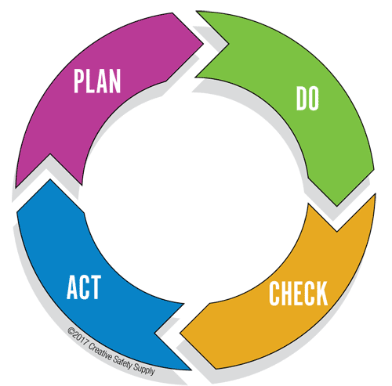
MEANING
QC is a small group of volunteered employees from same work area and doing similar work
Meet regularly to identify, analyze and solve problems in their work area

Slide 4
Objectives
Improve quality, productivity & profitability
Secure employee involvement, motivation & development
Improve management- employees relations
Improve communication at all levels
To develop team spirit among the employees
Provide better working environment to employees

Slide 5
QC PROCESS
QC – 4 to 12 members
First meeting- problem solving techniques
Brain storming sessions by QC specialist

Slide 6
STEPS IN QC
Listing of Problems
Selection of Problem
Analysis of Problem
Generating Solutions
Recommendations
Acceptance of Recommendations
Implementation
Rewarding the Employees

