Slide 1
COMPUTER SYSTEMS & APPLICATIONS
T.Y.B.COM. SEM VI
2020-21

Slide 2
Topics & Marks Allocation
Sr. No | Topic Name | Questions allotted
1 | E-commerce | 18
2 | MS-Excel | 20
3 | Visual Basic | 12

Slide 3
E-commerce

Slide 4
FAQ on E-Commerce
E-Commerce, Its Advantages & Disadvantages (Limitations)
Features of E-commerce
Types of E-commerce
Business Models in E-commerce
B2C Models
Security issues in E-commerce
Encryption & Decryption
Payment modes in E-commerce

Slide 5
E-Commerce Definition
E-Commerce is the process of doing business electronically, using information and communication technology.
Electronic Commerce means buying and selling of products or services by businesses and consumers over the internet.
E-commerce is the business environment in which information for buying, selling and transportation of goods and services moves electronically.
E-commerce means selling and buying products and services through web storefronts.
E-commerce is a modern business methodology.
It addresses the needs of organizations, merchants and consumers to cut cost and to improve the quality of goods and services.

Slide 6
Advantages
Reduced Cost
Time Saving
Lower advertising cost
Global scope
Better quality of products
Equal opportunities for all merchants
Online Payments
Availability

Slide 7
Disadvantages
All products not bought online
Security
Expensive to maintain the website
Technological limitations
Fulfillment problems
Hacking
Virus

Slide 8
Features of E-commerce:
Ubiquity:
Global Reach:
Universal Standards:
Information richness:
Interactivity:
Information Density:
Customization:
Social technology:

Slide 9
Features of E-commerce:
Ubiquity:
Global Reach:
Universal Standards:
Information richness:
Interactivity:
Information Density:
Customization:
Social technology:

Slide 10
Scope of E-commerce:
Electronic Market
EDI (Electronic Data Interchange)
Internet Commerce

Slide 11
EDI
EDI or Electronic Data Interchange is the virtual exchange of data or business documents in electronic format between trading partners.
This exchange of documents is generally between buyer and supplier and consists of transferring purchase orders, invoices, payments, shipping notices and various other documents and by nature eliminates paper trails, improves operational efficiency and enhances virtual exchanges with new trading partners.
With EDI, any company can virtually interact with another organisation anywhere in the world without the hassle of waiting times and forecasting future procedures.

Slide 12
Steps in an EDI System
Following are the steps in an EDI System.
A program generates a file that contains the processed document.
The document is converted into an agreed standard format.
The file containing the document is sent electronically on the network.
The trading partner receives the file.
An acknowledgement document is generated and sent to the originating organization.

Slide 13
Advantages of an EDI System
Following are the advantages of having an EDI system.
Reduction in data entry errors. − Chances of errors are much less while using a computer for data entry.
Shorter processing life cycle − Orders can be processed as soon as they are entered into the system. It reduces the processing time of the transfer documents.
Electronic form of data − It is quite easy to transfer or share the data, as it is present in electronic format.
Reduction in paperwork − As a lot of paper documents are replaced with electronic documents, there is a huge reduction in paperwork.
Cost Effective − As time is saved and orders are processed very effectively, EDI proves to be highly cost effective.
Standard Means of communication − EDI enforces standards on the content of data and its format which leads to clearer communication.

Slide 14
Types of E-Commerce
Business To Business (B2B)
Shop2gether.com , SeekandSource.com
Business To Consumer (B2C)
Amazon.com , Flipkart.com
Consumer To Consumer (C2C)
Ebay.com, Olx.com
Peer To Peer (P2P)
BitTorrent.com,

Slide 15
Business Revenue Models
Advertising Revenue Model
Yahoo.com, Rediff.com
Subscription Revenue Model
Consumerreports.org
Transaction Revenue Model
Ebay.com, sharekhnan.com
Sales Revenue Model
Amazon.com, Flipkart.com
Affiliate Revenue Model
Mypoints.com

Slide 16
B2C Models
Portal (MSN.com, yahoo.com)
E-tailer (Amazon.com)
Content Provider (Timesofindia.com)
Transaction Broker (Naukri.com)
Market Creator (ebay.com)
Service Provider (Google Maps, Orkut, Gmail)
Community Provider (Facebook, twitter)

Slide 17
E-Commerce Security Issues
Integrity
Ensures no changes or alteration
Non Repudiation
No denial from both the parties
Authenticity
Ensures the identity of person
Availability
Available all the time
Confidentiality
Ensures privacy of data

Slide 18
Encryption & Decryption
Encryption
Converting Plain Text to Cipher Text
Decryption
Converting Cipher Text to Plain Text
Private Key Encryption
Same Key is used to encrypt & decrypt
Public Key Encryption
Two keys are used.
Private Key for decryption
Public Key for encryption

Slide 19
Payment Modes
Digital Cash
Online Stored Value System
Digital Accumulating Balance Payment
Digital Credit Card System
Digital Checking
Digital Wallets

Slide 20
Other Terms
SSL (Secure Socket Layer)
HTTPS
Digital Signatures
Online Credit Card Transactions
SET(Secure Electronic Transaction)
M-Commerce

Slide 21
MS-Excel

Slide 22
MS-Excel Functions
String | Date | Statistical | Cond.
Lower() | Today() | Counta() | If()
Upper() | Now() | Countblank() | Countif()
Proper() | Date() | Correl() | Sumif()
Len() | Time() | Large() | Averageif()
Trim() | Day() | Small()
Left() | Month()
Right() | Year()
Mid() | Weekday()
Fixed() | Days360()

Slide 23
MS-Excel Functions
String | Date | Statistical | Conditional
Lower() | Today() | Counta() | If()
Upper() | Now() | Countblank() | Countif()
Proper() | Date() | Correl() | Sumif()
Len() | Time() | Large() | Averageif()
Trim() | Day() | Small()
Left() | Month()
Right() | Year()
Mid() | Weekday()
Fixed() | Days360()

Slide 24
MS-Excel String Functions
LEN()
It returns the number of characters in string
E.g. = LEN(“EXCEL”) will return 5
LEFT()
It returns the left most n characters from text value.
E.g. = LEFT(“COMPUTERS”,3) will return COM
RIGHT()
It returns the right most n characters for text value.
E.g. = RIGHT(“LIVE”,1) will return E
MID()
It returns n number of characters from m^{th} character position of the text string
E.g. = MID(“COMPUTER”,4,3) will return PUT

Slide 25
MS-Excel String Functions
LOWER()
It coverts text into lower case.
E.g. = LOWER(“EXCEL”) will return excel
UPPER()
It coverts text into upper case.
E.g. = U PPER(“excel”) will return EXCEL
PROPER()
It capitalizes 1st character in each word of the text value
E.g. = PROPER(“STRING FUNCTION”) will return String Function

Slide 26
MS-Excel String Functions
TRIM()
It removes all spaces from text
E.g. = TRIM(“ FINAL EXAM ”) will return FINAL EXAM
FIXED()
Rounds a number to the specified number of decimals, formats the number in decimal format using a period and commas, and returns the result as text.
Example : FIXED(1234.567, 1) returns 1,234.6
FIXED(-1234.567, -1) returns -1,230

Slide 27
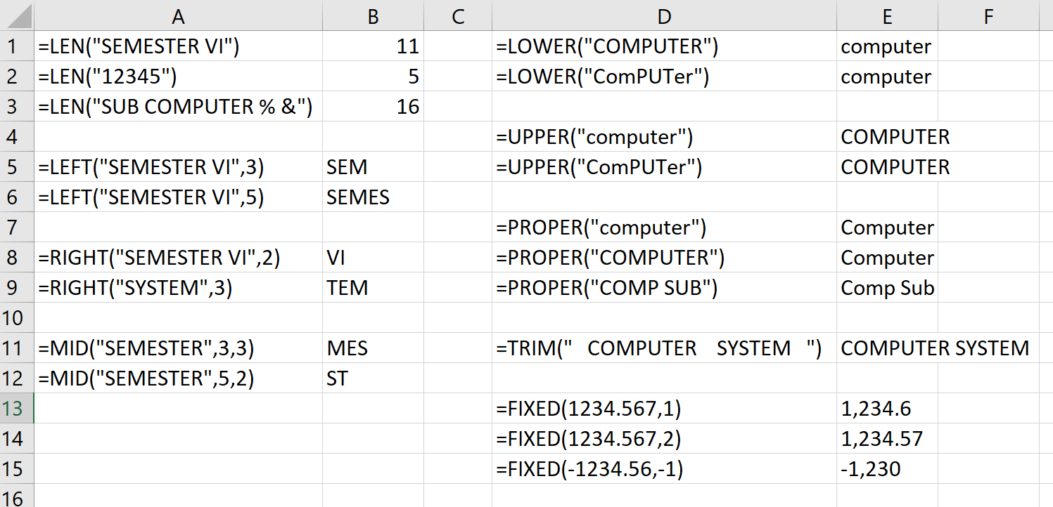
MS-Excel String Functions

Slide 28
MS-Excel Date & Time Functions
NOW()
It returns the current Date and Time.
E.g. = NOW() will return today’s date & time i.e.
4/23/2021 11:30
TODAY()
It returns the current Date. (mm/dd/yyyy)
E.g. = TODAY() will return today’s date i.e. 4/23/2021
DATE()
It returns a particular date.
E.g. = DATE (2020,1,12) will return 1/12/2020 (January 12, 2020)

Slide 29
MS-Excel Date & Time Functions
TIME()
It returns a particular time in hh:mm AM/PM form
E.g. = TIME(12,0,0) will return 12:00 PM
DAY()
It returns the day of the month corresponding to the serial_number. The day given as an integer ranging from 1 to 31
E.g. = DAY(“1/5/2021”) will returns the value 5 as it is the 5th day of month Jan
MONTH()
It returns the month corresponding to serial_number. The month is given as an integer ranging from 1 to 12.
E.g. = MONTH(“1/4/2021”) will returns the value 1 as it is the 1st month of year

Slide 30
MS-Excel Date & Time Functions
YEAR()
It returns the year corresponding to serial_number.
The year is given as an integer ranging from 1900 to 9999
E.g. = YEAR(“1/4/2021”) will return the value 2021
WEEKDAY()
It returns the day of the week for a date.
The day is given as an integer, ranging from 1 to 7.
DAYS360()
It returns the number of days between two dates based on a 360 day year (i.e. twelve 30 day month), which is used in some accounting calculations.
E.g. = DAYS360(“1/30/20”, “2/1/20”) will return 1, as Jan is considered a 30 days month

Slide 31
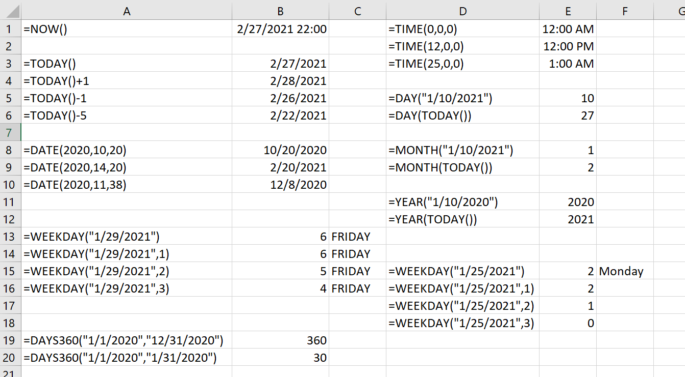
MS-Excel Date & Time Functions

Slide 32
MS-Excel Statistical Functions
COUNTA()
The COUNTA function counts the number of cells that are not empty in a range.
COUNTBLANK()
The COUNTBLANK function counts empty cells in a specified range of cells.
CORREL()
The CORREL function returns the correlation coefficient of the Array1 and Array2 cell ranges. Use the correlation coefficient to determine the relationship between two properties.
LARGE()
The LARGE function returns the k-th largest value in a data set. You can use this function to select a value based on its relative standing.
SMALL()
The Excel Small function returns the k'th smallest value from an array of numeric values.

Slide 33
MS-Excel Statistical Functions
COUNTIF()
The Excel Countif function returns the number of cells within a supplied range, that satisfy a given criteria.
Syntax : =COUNTIF( range, criteria )
AVERAGEIF()
The Excel AVERAGEIF function finds the values in a supplied array that satisfy a specified criteria, and returns the average (i.e. the statistical mean) of the corresponding values in a second supplied array.
Syntax : =AVERAGEIF( range, criteria, [average_range] )
SUMIF()
The Excel Sumif function finds the values in a supplied array, that satisfy a given criteria, and returns the sum of the corresponding values in a second supplied array.
Syntax : =SUMIF( range, criteria, [sum_range] )

Slide 34
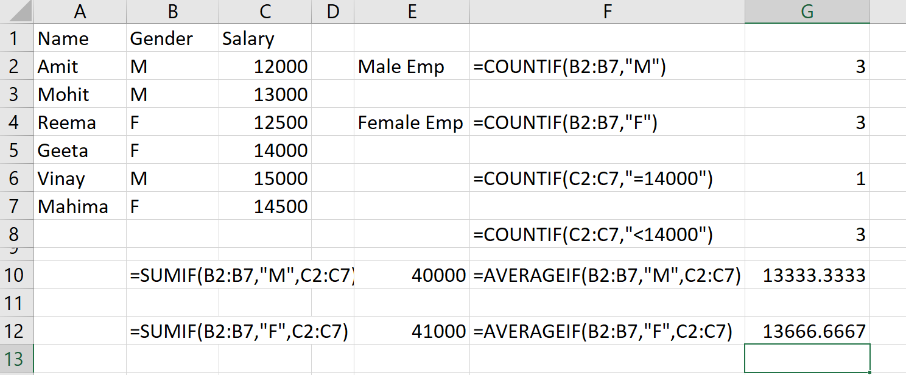
MS-Excel Statistical Functions

Slide 35
MS-Excel Logical Functions
IF():
The Excel IF function tests a supplied condition and returns one result if the condition evaluates to TRUE, and another result if the condition evaluates to FALSE.
Nested IF() :
The IF Function can be “Nested” which refers to a formula where at least one IF Function is nested inside another to test for more than one condition which in return give more possible results.
So, in “nested IF Statements” you must be very careful because each IF Statement needs to be nested inside another, so the logic is correct.

Slide 36
MS-Excel Logical Functions
AND() :
The Excel AND function tests a number of supplied conditions and returns:
TRUE if ALL of the conditions evaluate to TRUE
Or
FALSE otherwise (i.e. if ANY of the conditions evaluate to FALSE).
OR() :
The Excel OR function tests a number of supplied conditions and returns either:
TRUE if ANY of the conditions evaluate to TRUE
Or
FALSE otherwise (i.e. if ALL of the conditions evaluate to FALSE).

Slide 37
MS-Excel LookUp Functions
LOOKUP() Function
The Excel LOOKUP function performs an approximate match lookup in a one-column or one-row range, and returns the corresponding value from another one-column or one-row range.
The Microsoft Excel LOOKUP function returns a value from a range (one row or one column) or from an array.
Syntax :
=LOOKUP (lookup_value, lookup_range, [result_range])

Slide 38
MS-Excel LookUp Functions
HLOOKUP() Function
Searches a value from horizontal policy table
The Microsoft Excel HLOOKUP function performs a horizontal lookup by searching for a value in the top row of the table and returning the value in the same column based on the index_number.
The HLOOKUP function is a built-in function in Excel that is categorized as a Lookup/Reference Function. It can be used as a worksheet function (WS) in Excel.
Syntax :
=HLOOKUP (lookup_value, lookup_table, ,row_number[range_lookup])

Slide 39
MS-Excel LookUp Functions
VLOOKUP() Function
Searches a value from vertical policy table
The VLOOKUP function performs a vertical lookup by searching for a value in the first column of a table and returning the value in the same row in the index_number position.
The VLOOKUP function is a built-in function in Excel that is categorized as a Lookup/Reference Function. It can be used as a worksheet function (WS) in Excel.
Syntax :
=VLOOKUP (lookup_value, lookup_table, ,col_number[range_lookup])

Slide 40
Advanced features MS-Excel
Filter
Filtering data in MS Excel refers to displaying only the rows that meet certain conditions. (The other rows gets hidden.)
This is a quick way to display only the information that is needed by you.
You can Filter data in a Range, table or PivotTable.
Excel provides two ways of filtering data
AutoFilter
Advanced Filter

Slide 41
Advanced features MS-Excel
Charts
Graphical representation of numerical data .
Chart Types
Column Chart
Bar Chart
Line Chart
Pie Chart
XY Chart
Chart elements

Slide 42
MS-Excel What-If Analysis
Excel includes many powerful tools to perform complex mathematical calculations, including what-if analysis.
This feature can help to experiment and answer questions with different data, even when the data is incomplete.
What-if analysis is the process of changing the values in cells to see how those changes will affect the outcome of formulas on the worksheet.

Slide 43
MS-Excel What-If Analysis
Goal Seek
A Goal Seek is a tool that is used to find an unknown value from a set of known values.
Note :- Goal Seek can be used only with one variable input value.
The set cell should always be the resulting cell.
To value should always have a numeric value.
Solver
Solver comes with Excel as an add-in. Solver is used to find an optimal value for a formula in a cell called the target cell on a worksheet.

Slide 44
MS-Excel What-If Analysis
Scenario Manager
Scenario Manager is a what-if analysis tool available in excel which works on different scenarios provided to it, it uses a group of ranges which impact on a certain output and can be used for making different scenarios such as well bad and medium depending on the values present in the range which impact the result.
A scenario is a set of values that Excel saves and can substitute automatically in cells on a worksheet.
You can create and save different groups of values on a worksheet and then switch to any of these new scenarios to view different results.

Slide 45
MS-Excel What-If Analysis
Macros :
Macros are the tool that automates the tasks and saves time and reduces errors.
A Macro is a program that copies keystrokes or mouse actions that are repeated and are common in the sheet.
In short, Excel Macros refers to the programming language in VBA (Visual Basic Application ). Macros are short programs written in VBA. We can record/write macros in VBA and can run a macro by clicking the Macros command on the Developer tab on the ribbon. Macros are written to automate tasks and save time and assure efficiency.

Slide 46
Other Terms in MS-Excel
Excel Template:
A Microsoft Excel template is a predesigned sheet with a fixed format and default settings where most of the work is done for us.
The templates is saved with the extension .xltx.
Ranges in Excel
A cell is a single element in a worksheet that can hold a value, some text, or a formula. A cell is identified by its address, which consists of its column letter and row number.
Named Range in Excel :
An Excel Named Range is created by allocating a chosen name to a specified range of cells. Once defined, the named range can then be used in functions and formulas, instead of the standard cell reference.
Named Range just makes the process of working with formulas very interesting, especially to keep track of things.

Slide 47
Visual Basic

Slide 48
VB
Visual Basic is a third-generation event-driven programming language first released by Microsoft in 1991.
BASIC means Beginners' All-purpose Symbolic Instruction Code.
Visual Basic is a user-friendly programming language designed for beginners, and it enables anyone to develop GUI window applications easily.
Visual Basic (VB) is useful in developing windows, web and device applications.
Visual Basic is a fully Event-driven and visual programming language.

Slide 49
Components of Visual Basic
Object
An object is a type of user interface element you create on a Visual Basic form by using a toolbox control. In fact, in Visual Basic, the form itself is an object. Every Visual Basic control consists of three important elements −
Properties :
A property is an attribute of an object that defines one of the object's characteristics, such as size, color, or screen location, or an aspect of its behavior, such as whether it is enabled or visible. To change the characteristics of an object, we can change the values of its properties.
Methods :
A method is an action that an object can perform. For example, Add is a method of the ComboBox object that adds a new entry to a combo box.
Events :
An event is an action recognized by an object, such as clicking the mouse or pressing a key, and for which you can write code to respond. Events can occur as a result of a user action or program code, or they can be caused by the system. Code that signals an event is said to raise the event, and code that responds to it is said to handle it.

Slide 50
Types of files in a VB Project
Visual Project consist various files as follows:
.vbp file: This file is called the project file, is a small text file that holds the names of the other files in the project, as well as some information about the VB environment.
.frm file: Each form in the project is saved in a file with .FRM extension.. A from holds the description of all objects and their properties for each form, as well as the basic code that you have written to respond to the events. These are also referred as form modules.
.bas file: Each project has this file. These file holds basic statements or programming code that can be accessed from any form. These files are called standard code modules.
.ocx file: additional controls, called custom controls, are stored with a file .ocx extension. If we include controls in the projects that are not part of the standard control set, the .ocx file names will be included in the project.
.vbw file: After the project is saves , Visual Basic automatically adds one more file to the project with extension of .vbw. This file holds information about each project’s form.

Slide 51
Integrated Development Environment (IDE)
IDE is a term commonly used in the programming world to describe the interface and environment that is used to create an application.
It is called integrated because we can access virtually all of the development tools that we need from one screen called an interface.
The IDE is also commonly referred to as the design environment, or the program.
The Visual Basic IDE is made up of a number of components
Menu Bar
Tool Bar
Project Explorer
Properties window
Form Layout Window
Toolbox
Form Designer

Slide 52
Integrated Development Environment (IDE)

Slide 53
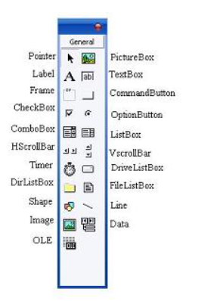
Integrated Development Environment (IDE)
Toolbox
The toolbox is simply a library of controls which we can place on the application. The Toolbox contains a set of controls that are used to place on a Form at design time thereby creating the user interface area. Additional controls can be included in the toolbox by using the Components menu item on the Project menu.

Slide 54
The Form Object
The Form is where the user interface is drawn.
It is central to the development of Visual Basic applications.
It contains all other GUI components such as text box, command button , label etc.
Form Properties:
Property | Description
Name | Used to give a name to a form
Caption | It sets the form window title
BackColor | Sets the form background color
BorderStyle | Sets the form border to be fixed or sizeable.
MaxButton | It can be True or False. If set to False, the maximize button is not displayed
MinButton | It can be True or False. If set to False, the minimize button is not displayed
Top and Left | It determine the position or location of the form on the window
Width and Height | It decides the size of the form.

Slide 55
The Form Object
Form Methods:
Examples
frmExample.Cls clears the form
frmExample.Print "This will print on the form"
Method | Description
Cls | Clears all graphics and text from form. Does not clear any objects
Print | Prints text string on the form
Open | Used to open a form
Move | Used to move a form to a new position.

Slide 56
The Form Object
Form Events:
Events | Description
Click | Form_Click event is triggered when user clicks on form.
DblClick | Form_DblClick event is triggered when user doubleclicks on form
Load | Form_Load event occurs when form is loaded.
Unload | Form_Unload event occurs when form is unloaded
Resize | Form_Resize event occurs when auser resizes a window

Slide 57
The Command Button
The Command Button control is use to create buttons with a variety of uses on a form.
A command button is the most basic way to get user input while a program is running.
By clicking a command button, the user requests that a specific action be taken in the program.
Command Button Properties:
Property | Description
Name | Used to give a name to a command button
Caption | Text to be displayed on button
Cancel | Allows selection of button with Esc key (only one button on a form can have this property True)
Default | Allows selection of button with Enter key (only one button on a form can have this property True).
BackColor | Sets the command button background color
TabIndex | Sets the order in which the controls will get focus when the tab key is pressed
ToolTipText | When this property is set, the text will popup over the command button when user hovers the mouse pointer over it.

Slide 58
Command Button Methods:
Command Button Events:
Method | Description
Move | Used to move a command button during program execution.
SetFocus | Sets the focus to command button
Events | Description
Click | Event triggered when button is selected either by clicking on it or by pressing the access key.
GotFocus | Occurs when the button gets focus either from the tab key, when it is clicked on by the user or by using the SetFocus
LostFocus | It occurs when the command button loses focus.

Slide 59
The Text Box
A Textbox is used to display information entered at design time, by a user at run-time, or assigned within code.
The displayed text may be edited.
The Textbox control is one of the most versatile tools in the Visual Basic toolbox.
This control performs two functions:
Displaying output (such as operating instructions or the contents of a file) on a form.
Receiving text (such as names and phone numbers) as user input.

Slide 60
The Text Box
Text Box Properties: txtName.Text=“Sumit” txtName=“Sumit”
Property | Description
Name | Used to give a name to a text box
Alignment | To change the alignment of text within the text box. The values can only be set at design time and not at run time.
Enabled | Value must be True or False. If False, user cannot enter data into the text box but can be displayed through the program.
MaxLength | Limits the length of displayed text (0 value indicates unlimited length)
MultiLine | Specifies whether text box displays single line or multiple lines
Text (Default Property) | To read or set the text in the text box.
PasswordChar | Hides text with a single character
Font | Sets font type, style, size.

Slide 61
Text Box Methods:
Text Box Events:
Method | Description
SetFocus | Sets the focus to text box
Events | Description
Change | Triggered every time the Text property changes
Click | Event triggered when button is selected either by clicking on it or by pressing the access key.
GotFocus | Occurs when the text box gets focus either from the tab key, when it is clicked on by the user or by using the SetFocus
LostFocus | It occurs when the text box loses focus.
KeyPress | Triggered whenever a key is pressed. Used for key trapping, as seen in last class.
KeyDown | Triggered when a key is pressed while the focus is in a text box.
KeyUp | Triggered when a key is released while the focus is in a text box.

Slide 62
The Label
Label, the simplest control in the Visual Basic toolbox, displays formatted text on a user interface form.
The label cannot be changed directly by the user at run time.
Its contents can be changed through the program or at design time.
Typical uses for the Label control include:
Help text
Program splash screen headings
Formatted output, such as names, times, and dates
Descriptive labels for other objects, including text boxes and list boxes.

Slide 63
The Label
Label Properties:
Property | Description
Name | Used to give a name to a label
Alignment | Aligns caption within border.
Caption (Default Property) | Text to be displayed on the label. This can be changed at design time or at run time
FontBold | To display the text in a bold font
FontItalic | To display the text in a italic font
WordWarp | If True, the text in the caption will display in multiple lines.

Slide 64
Label Methods:
Label Events:
Method | Description
Move | Moves the label at run time
Events | Description
Click | Event triggered when user clicks on a label.
DblClick | Event triggered when user double-clicks on a label
Change | Triggered when the text of the label is changed by the application.

Slide 65
The Check Box
Check boxes provide a way to make choices from a list of potential options.
Some, all, or none of the choices in a group may be selected
In any group of check boxes, any number of check boxes can be selected.
If check box is selected , its Value property becomes 1 otherwise it becomes 0.
Check Box Properties:
Check Box Events:
Property | Description
Name | Used to give a name to a check box
Caption | Identifying text next to box
Value (Default Property) | Indicates if unchecked (0, vbUnchecked), checked (1,vbChecked), or grayed out (2, vbGrayed).
Events | Description
Click | Triggered when a box is clicked. Value property is automatically changed by VB

Slide 66
The Option Button (Radio Button)
Option buttons provide the capability to make a mutually exclusive choice among a group of potential candidate choices.
Hence, option buttons work as a group, only one of which can have a True (or selected) value.
All related option buttons must be placed inside the frame and not on the form.
Option Button Properties:
Option Button Events:
Property | Description
Name | Used to give a name to a option button
Caption | Identifying text next to option button
Value (Default Property) | Indicates if selected (True) or not (False). Only one option button in a group can be True. One button in each group of option buttons should always be initialized to True at design time.
Events | Description
Click | Triggered when a option button is clicked. Value property is automatically changed by VB

Slide 67
List Box
A list box displays a list of items from which the user can select one or more items.
If the number of items exceeds the number that can be displayed, a scroll bar is automatically added.
List Box Properties:
Property | Description
Name | Used to give a name to a list box
List | Array of items in list box
ListCount | Number of items in list.
ListIndex | The number of the most recently selected item in list
MultiSelect | Controls how items may be selected (0-no multiple selection allowed, 1-multiple selection allowed, 2-group selection allowed)
Selected | Array with elements set equal to True or False,depending on whether corresponding list item is selected.
Sorted | True means items are sorted in Ascii order, else items appear in order added.
Text | Text of most recently selected item.

Slide 68
List Box Methods:
List Box Events:
Method | Description
Click | Event triggered when item in list is clicked
DblClick | Event triggered when item in list is double-clicked.Primary way used to process selection.
Events | Description
AddItem | Allows you to insert item in list
Clear | Removes all items from list box.
RemoveItem | Removes item from list box, as identified by index of item to remove.

Slide 69
Combo Box
The combo box is similar to the list box.
The differences are a combo box includes a text box on top of a list box and only allows selection of one item.
In some cases, the user can type in an alternate response.
Combo Box Properties:
Property | Description
Name | Used to give a name to a Combo box
List | Array of items in list box
ListCount | Number of items in list.
ListIndex | The number of the most recently selected item in list
Style | Selects the combo box form.Style = 0, Dropdown combo; user can change selection.Style = 1, Simple combo; user can change selection. Style = 2, Dropdown combo; user cannot change selection.
Sorted | True means items are sorted in Ascii order, else items appear in order added.
Text | Text of most recently selected item.

Slide 70
Combo Box Methods:
Combo Box Events:
Method | Description
Click | Event triggered when item in list is clicked
DblClick | Event triggered when item in list is double-clicked.Primary way used to process selection.
Events | Description
AddItem | Allows you to insert item in list
Clear | Removes all items from list box.
RemoveItem | Removes item from list box, as identified by index of item to remove.

Slide 71
Picture Boxes
The picture box allows you to place graphics information on a form.
It is best suited for dynamic environments - for example, when doing animation.
They behave very much like small forms within a form, possessing most of the same properties as a form.
Picture Box Properties:
Picture Box Events:
Property | Description
Name | Used to give name for the picture box
Font | Sets the font size, style, and size of any printing done in the picture box
Picture | Establishes the graphics file to display in the picture box
Method | Description
Click | Triggered when a picture box is clicked
DblClick | Triggered when a picture box is double- clicked.

Slide 72
Image Tool
The image box holds a picture.
Set the Picture property to an image file with extension .JPG, .BMP, .GIF, .CUR or .WMF
Image Tool Box Properties:
Image Tool Events:
Property | Description
Name | Name of the picture box
Picture (Default Property) | Establishes the graphics file to display in the image box
Stretch | Specifies whether a picture is to be resized to fit the size of the image control
Method | Description
Click | Triggered when a image control is clicked

Slide 73
Frames
Frames provide a way of grouping related controls on a form. And, in the case of option buttons, frames affect how such buttons operate.
Option buttons within a frame work as a group, independently of option buttons in other frames.
Option buttons on the form, and not in frames, work as another independent group.
That is, the form is itself a frame by default.
It is important to note that an independent group of option buttons is defined by physical location within frames, not according to naming convention.
That is, a control array of option buttons does not work as an independent group just because it is a control array.
It would only work as a group if it were the only group of option buttons within a frame or on the form.

Slide 74
Object Naming Conventions on VB
Object | Prefix | Example
Form | frm | frmMain
Lablel | lbl | lblName
Text Box | txt | txtName
Command Button | cmd | cmdSave
Check Box | chk | chkLanguage
Option Button | opt | optMale
Combo Box | cbo | cboCounty
List Box | lst | lstHobbies
Image | img | imgIcon
Picture Box | pic | picStudent
Frame | fra | fraGender
Line | lin | linVertical
Shape | shp | shpCircle
Menu | mnu | mnuFile

Slide 75
Modes in VB
Visual Basic has three modes
Design Time :-
The IDE is in design mode when we are writing code or designing a form. The error occurs in the IDE and before compiling the program are called Design Time Errors. Syntax Errors are detected at this stage.
Run Time :-
Run mode occurs when a procedure is running. To run (or execute) a procedure, just place the cursor anywhere within the procedure code and hit the F5 key (or select Run from the Run menu). Certain errors that can be detected only on running the program are called Run time errors.
Break Time :-
Break mode is entered when a running procedure stops because of either an error in the code. In particular, if an error occurs, VB will stop execution and display an error dialog box with an error message.

Slide 76
Errors in VB
Three types of errors can be occurred while running a VB project
Compile Time Error (Syntax Error):-
These are grammatical errors in the formulation of statements and are picked up by the interpreter while you are typing in the code.
Run Time Errors:-
These are errors that cannot be detected until the program is running. The syntax of the statements is correct, but on execution they cause a situation to arise that results in a crash or an undefined value. Run-time errors are those that appear only after you compile and run your code. These involve code that may appear to be correct in that it has no syntax errors, but that will not execute
Logical Errors:-
These are errors that cause the program to behave incorrectly. These are human generated errors. In this program will execute but will give wrong result. ‘<’ instead of ‘<=’, use of ‘and’ instead of ‘or’, or omission of a crucial step in the processing. Logic errors can not be detected by the complier but must be tracked down by the programmer. This is why careful testing is so important.

Slide 77
Variables
Variables are the memory locations which are used to store values temporarily.
Variables will represent storage locations and each variable will have a particular data type to determine the type of values the variable can hold.
Visual Basic is a Strongly Typed programming language so before we perform any operation on variables, it’s mandatory to define the variable with a required data type to indicate that the type of data the variable can hold in our application.

Slide 78
Variables
There are many ways of declaring variables in Visual Basic.
Syntax :
Dim [Variable Name] As [Data Type]
Dim [Variable Name] As [Data Type] = [Value]
Where ,
Dim : It is useful to declare and allocate the storage space for one or more variables.
[Variable Name] :It’s the name of the variable to hold the values in our application.
As :The As clause in the declaration statement allows you to define the data type.
[Data Type] :t’s a type of data the variable can hold such as integer, string, decimal, etc.
[Value] :Assigning a required value to the variable.
For example,
Dim strName As String Dim intCounter As Integer = 100

Slide 79
Constants
Constants are different from variables in the sense that their values do not change during the running of the program.
We can create your own constant to use it in your program.
The value of the constant remains unchanged throughout the program.
Declaring a Constant
The syntax to declare a constant is
Constant Name As Data Type = Value
Example
Const Pi As Single = 3.142

Slide 80
Types of Constants
Intrinsic Constants :
These are system defined or pre-defined constants. These constants need not be declared and can be used directly. These constants start with the prefix vb.
E.g. vbRed, vbBlue
Named Constants :
These are declared by using the keyword Const. It can be declared with constant name , data type and its value.
E.g. Const PI As Single = 3.142

Slide 81
Visual Basic Keywords
In visual basic, Keywords are the predefined set of reserved words that have special meaning for the compiler.
So the keywords in visual basic cannot be used as identifiers such as variable name, class name, etc. in our applications.
Generally, the reserved keywords will not allow us to use them as names for programming elements such as variables, class, etc.
Example : As, Case, ByRef, ByVal, Default , Dim, Exit, Loop, If, Select, Static , For , False , Const etc.

Slide 82
Numeric Data Types
Date Type | Purpose | Prefix | Storage | Range
Byte | A single ASCII character | byt | 1 byte | 0 to 255
Integer | To store integer values | int | 2 byte | -32,768 to 32,767
Long | To store large integer values | lng | 4 byte | -2,147,483,648 to 2,147,483,648
Single | To store single precision floating point value (6 digit) | sng | 4 byte | -3.402823E+38 to -1.401298E-45 for negative values 1.401298E-45 to 3.402823E+38 for positive values.
Double | To store single precision floating point value (14 digit) | dbl | 8 byte | -1.79769313486232e+308 to -4.94065645841247E-324 for negative values 4.94065645841247E-324 to 1.79769313486232e+308 for positive values.
Currency | To store decimal fractions such as rupees, paisa, dollars etc | cur | 8 byte | -922,337,203,685,477.5808 to 922,337,203,685,477.5807
Decimal | To store decimal values | dec | 12 bytes | +/- 79,228,162,514,264,337,593,543,950,335 if no decimal is use +/- 7.9228162514264337593543950335 (28 decimal places).

Slide 83
Non-Numeric Data Types
Nonnumeric data types are data that cannot be manipulated mathematically.
Non-numeric data comprises string data types, date data types, Boolean data types that store only two values (true or false), object data type and Variant data type .
Date Type | Purpose | Prefix | Storage | Range
Boolean | To store True or False value | bln | 2 byte | True or False
String | To store alphanumeric data such as letters, digits and other characters | str | Length + 10 bytes | 0 to 2 billion characters
Date | To store date values | dtm | 8 byte | January 1, 100 to December 31, 9999
Variant | Converts from one data type to another | vnt | 16 bytes | Any value as large as Double

Slide 84
Arithmetic Operators
In Visual Basic, Arithmetic Operators are useful to perform the basic arithmetic calculations like addition, subtraction, division, etc. based on the requirements.
The following table lists the different types of arithmetic operators available in Visual Basic.
Operator | Description | Example(a=4,b=2)
+ | It will add two operands. | a + b = 6
– | It will subtract two operands. | a – b = 2
* | It will multiply two operands. | a * b = 8
/ | It divides two numbers and returns a floating-point result. | a / b = 2
^ | It raises a number to the power of another number. | a ^ b = 16
Mod | It divides two numbers and returns only the remainder. | a Mod b = 0

Slide 85
Relational Operators
In Visual Basic, Comparison Operators are useful to determine whether the defined two operands are equal, greater than or less than, etc. based on our requirements.
The following table lists the different types of comparison operators available in Visual Basic.
Operator | Description | Example(a=10,b=5)
< | It will return true if right operand greater than left operand. | a < b = False
<= | It will return true if right operand greater than or equal to the left operand. | a <= b = False
> | It will return true if left operand greater than the right operand. | a > b = True
>= | It will return true if left operand greater than or equal to the right operand. | a >= b = True
= | It will return true if both operands are equal. | a = b = False
<> | It will return true if both operands are not equal. | a <> b = True

Slide 86
Logical Operators
In Visual Basic, Logical / Bitwise Operators are useful to perform the logical operation between two operands like AND, OR, etc. based on our requirements. The Logical / Bitwise Operators will always work with Boolean expressions (true or false) and return Boolean values.
The following table lists the different types of logical/bitwise operators available in Visual Basic.
Operator | Description | Example(a=True, b=False)
And | It will return true if both operands are non zero. | a And b = False
Or | It will return true if any one operand becomes a non zero. | a Or b = True
Not | It will return the reverse of a logical state that means if both operands are non zero then it will return false. | Not(a And b) = True

Slide 87
Formatting Function
It is important to make sure that results of an expression are formatted nicely if the output is to be displayed to the user. Visual Basic provides a number of formatting functions that can be used to display values nicely.
The FormatCurrency function returns a string of characters formatted as a monetary amount with a dollar sign, commas if necessary, and two positions to the right of a decimal point.
Syntax : FormatCurrency(Value, no_of_decimal_positions)
For example,
FormatCurrency(1345.236) = $1,345.24
FormatCurrency(0.5) = $0.50
FormatCurrency(1345.236578,3) = $1,345.247

Slide 88
Formatting Function
The FormatNumber function works similarly as the FormatCurrency function except that the dollar sign is not outputted. It is easy to prevent the numbers to the right of the decimal from being displayed by adding a second argument.
Syntax : FormatNumber(Value, no_of_decimal_positions)
For example,
FormatNumber(1345.236, 0) = 1,345
FormatNumber(1345.236, 2) = 1,345.24

Slide 89
Formatting Function
The FormatPercent function can be used to automatically multiply the argument by 100 and add a percent sign.
Syntax : FormatPercent(Value, no_of_decimal_positions)
For example,
FormatPercent(.8241, 0) = 82%
FormatPercent(.8241, 1) = 82.4%
FormatPercent(.8241) = 82%

Slide 90
Formatting Function
The FormatDateTime function works along with predefined formats to display dates and/or times.
Syntax : FormatDateTime(expression-to-format,[named format])
vbGeneralDate – 3/16/2021 8:30:20 AM
vbLongDate – Tuesday, March 16, 2021
vbShortDate – 3/16/2021
vbLongTime – 8:20:10 AM
vbShortTime. – 15:10 (24 hr clock)
For example,
FormatDateTime("9/10/98", vbGeneralDate) = 9/10/1998 5:23:12 PM .

Slide 91
Control Structures
Control Statements are used to control the flow of program's execution.
Conditional operators are used in control structures which are very powerful tools, they let the VB program compare data values and then decide what action to take, whether to execute a program or terminate the program and more.
Visual Basic supports control structures such as
If... Then
If...Then ...Else
Select...Case.

Slide 92
Message Box
Syntax :
MsgBox ( Prompt [,icons+buttons ] [,title ] )
memory_variable = MsgBox ( prompt [, icons+ buttons] [,title] )
Prompt : String expressions displayed as the message in the dialog box. If prompt consist of more than one line, you can separate the lines using the vbrCrLf constant.
Icons + Buttons : Numeric expression that is the sum of values specifying the number and type of buttons and icon to display.
Title : String expression displayed in the title bar of the dialog box. If you omit title, the application name is placed in the title bar.

Slide 93
Message Box
Buttons
Icons
Constant | Value | Description
vbOkOnly | 0 | Display OK button only
vbOkCancel | 1 | Display OK and Cancel buttons
vbAbortRetryIgnore | 2 | Display Abort, Retry and Ignore buttons
vbYesNoCancel | 3 | Display Yes, No and Cancel buttons
vbYesNo | 4 | Display Yes and No buttons
vbRetryCancel | 5 | Display Retry and Cancel buttons
Constant | Value | Description
vbCritical | 16 | Display Critical message icon
vbQuestion | 32 | Display Warning Query icon
vbExclamation | 48 | Display Warning message icon
vbInformation | 64 | Display information icon

Slide 94
Message Box
Return Values
Examples
MsgBox “Enter the Number", vbOkOnly, “Number not entered“
MsgBox "No names is selected", vbInformation, "Error“
MsgBox("Do you want to quit?", vbExclamation + vbYesNo, "Confirm")
Constant | Value | Description
vbOk | 1 | Ok Button
vbCancel | 2 | Cancel Button
vbAbort | 3 | Abort Button
vbRetry | 4 | Retry Button
vbIgnore | 5 | Ignore Button
vbYes | 6 | Yes Button
vbNo | 7 | No Button

Slide 95
Loops
In Visual Basic, For loop is useful to execute a statement or a group of statements repeatedly until the defined condition returns true.
Generally, For loop is useful in Visual Basic applications to iterate and execute a certain block of statements repeatedly until the specified number of times.
Looping is a very useful feature of Visual Basic because it makes repetitive works easier.
There are three kinds of loops in VB the Do...Loop ,the For.......Next loop and the While.....Wend Loop.

Slide 96
Do Loop
The Do Loop statements have four different forms, as shown below:
Do while counter <=1000
num.Text=counter
counter =counter+1 Loop
* The above example will keep on adding until counter > 1000
The above example can be rewritten as
Do
counter=counter+1
Loop until counter>1000
Do While condition Block of one or more VB statements Loop | Do Block of one or more VB statements Loop While condition
Do Until condition Block of one or more VB statements Loop | Do Block of one or more VB statements Loop Until condition

Slide 97
Do Loop
Do...Loop While Statement
The Do...Loop While statement first executes the statements and then test the condition after each execution. The following program block illustrates the structure:
Dim number As Long number = 0 Do number = number + 1 Loop While number < 201
The programs executes the statements between Do and Loop While structure in any case.
Then it determines whether the counter is less than 201.
If so, the program again executes the statements between Do and Loop While else exits the Loop.

Slide 98
Do While …..Loop
The Do While...Loop is used to execute statements until a certain condition is met. The following Do Loop counts from 1 to 100.
Dim number As Integer number = 1 Do While number <= 100 number = number + 1 Loop
A variable number is initialized to 1 and then the Do While Loop starts.
First, the condition is tested; if condition is True, then the statements are executed.
When it gets to the Loop it goes back to the Do and tests condition again.
If condition is False on the first pass, the statements are never executed.

Slide 99
Do Until …..Loop
Do Until...Loop Statement
Unlike the Do While...Loop and While...Wend repetition structures, the Do Until... Loop structure tests a condition for falsity. Statements in the body of a Do Until...Loop are executed repeatedly as long as the loop-continuation test evaluates to False.
An example for Do Until...Loop statement. The coding is typed inside the click event of the command button
Dim number As Long number=0 Do Until number > 1000 number = number + 1 Print number Loop
Numbers between 1 to 1000 will be displayed on the form as soon as you click on the command button.

Slide 100
The For....Next Loop
The For....Next Loop event procedure is written as follows:
For counter=startNumber to endNumber (Step increment) One or more VB statements Next
Private Sub Command1_Click()
Dim counter As Integer
For counter = 1 To 1000 Step 10
counter = counter + 1
Print counter
Next
End Sub

Slide 101
The For....Next Loop
The For...Next Loop is another way to make loops in Visual Basic. For...Next repetition structure handles all the details of counter-controlled repetition. The following loop counts the numbers from 1 to 100:
Dim x As Integer For x = 1 To 50 Print x Next
In order to count the numbers from 1 yo 50 in steps of 2, the following loop can be used
For x = 1 To 50 Step 2 Print x Next
The following loop counts numbers as 1, 3, 5, 7..etc

Slide 102
Common Dialog Control
The Common Dialog Control provides a standard interface for operations such as opening, saving, and printing files or selecting colours and fonts using the Microsoft Windows dynamic link library COMMDLG.DLL.
The Control is visible on the form as an icon at design-time but not at run-time.
The icon cannot be resized on the form and it's not possible to specify where the Dialog will be displayed when opened. To use a Common Dialog Control, add "Microsoft Common Dialog Control" from the "Project", "Components" menu item.
The three-letter mnemonic for a Common Dialog Control is "dlg".
The Control's Methods are used to determine which dialog is displayed.

Slide 103
Procedures in VB
A procedure is a block of Visual Basic statements enclosed by a declaration statement (Function, Sub, Operator, Get, Set) and a matching End declaration. All executable statements in Visual Basic must be within some procedure.
Visual Basic programs can be broken into smaller logical components called Procedures. Procedures are useful for condensing repeated operations such as the frequently used calculations, text and control manipulation etc.
The benefits of using procedures in programming are:It is easier to debug a program a program with procedures, which breaks a program into discrete logical limits.
Procedures used in one program can act as building blocks for other programs with slight modifications.
Visual Basic offers different types of procedures to execute small sections of coding in applications.
A Procedure can be Sub, Function or Property Procedure.

Slide 104
Event Procedures
An event procedure is a procedure block that contains the control's actual name, an underscore(_), and the event name. The following syntax represents the event procedure for a Form_Load event.
Private Sub Form_Load() ....statement block.. End Sub
Event Procedures acquire the declarations as Private by default.

Slide 105
General Procedures
A general procedure is declared when several event procedures perform the same actions. It is a good programming practice to write common statements in a separate procedure (general procedure) and then call them in the event procedure.
In order to add General procedure:
The Code window is opened for the module to which the procedure is to be added.
The Add Procedure option is chosen from the Tools menu, which opens an Add Procedure dialog box as shown in the figure given below.
The name of the procedure is typed in the Name textbox
Under Type, Sub is selected to create a Sub procedure, Function to create a Function procedure or Property to create a Property procedure.
Under Scope, Public is selected to create a procedure that can be invoked outside the module, or Private to create a procedure that can be invoked only from within the module.

Slide 106
Sub Procedures
A sub procedure can be placed in standard, class and form modules. Each time the procedure is called, the statements between Sub and End Sub are executed. The syntax for a sub procedure is as follows:
[Private | Public] [Static] Sub Procedurename [( arglist)] [ statements] End Sub
arglist is a list of argument names separated by commas. Each argument acts like a variable in the procedure.

Slide 107
Function Procedures
Functions are like sub procedures, except they return a value to the calling procedure. They are especially useful for taking one or more pieces of data, called arguments and performing some tasks with them. Then the functions returns a value that indicates the results of the tasks complete within the function.
Property Procedures
A property procedure is used to create and manipulate custom properties. It is used to create read only properties for Forms, Standard modules and Class modules. Visual Basic provides three kind of property procedures-Property Let procedure that sets the value of a property, Property Get procedure that returns the value of a property, and Property Set procedure that sets the references to an object.

Slide 108
Passing Arguments to Procedures
In Visual Basic, variables that are passed from one procedure to another procedure are called arguments or parameters.
This is known as the passing mechanism, and it determines whether the procedure can modify the programming element underlying the argument in the calling code.
Arguments can be passed to a procedure or a function either by value or by reference.
The procedure declaration determines the passing mechanism for each parameter by specifying the ByVal or ByRef keyword.

