Slide 1
Visual Basic

Slide 2
Introduction
Visual Basic is a third-generation event-driven programming language first released by Microsoft in 1991.
It evolved from the earlier DOS version called BASIC.
BASIC means Beginners' All-purpose Symbolic Instruction Code.
Since then Microsoft has released many versions of Visual Basic, from Visual Basic 1.0 to the final version Visual Basic 6.0.
Visual Basic is a user-friendly programming language designed for beginners, and it enables anyone to develop GUI window applications easily.
Visual Basic language has its roots from the family of C languages such as C, C++ and it is mostly similar to Java programming.
Visual Basic (VB) Programming language will allow developers to build a variety of secure and robust applications such as windows applications, web applications, database applications, etc.

Slide 3
Features of Visual Basic (VB)
Visual Basic (VB) contains various features that make it similar to other programming languages such as C, C++, and Java.
VB is a modern programming language and it is very powerful, simple for building the applications
Visual Basic (VB) is useful in developing windows, web and device applications.
VB provides a structured and extensible approach for error detection and recovery.
Visual Basic is a fully Event-driven and visual programming language.

Slide 4
Programming Language
A computer or a system is operated by given a set of rules and instruction to perform some task.
These set of rules and instructions are able to control the working of computer or any automated and/or manipulated machine.
To control the computer system using these sequential set of grammatical rules are known as programming language.
In other words, a programming language is an artificial language that can be used to write programs that control the behavior of a machine, particularly a computer.
Programming languages are defined by rules which describe their structure and meaning respectively.
Many programming languages have some form of written specification of their syntax.

Slide 5
Classification of Programming Language
Procedural-Oriented language (3GL)
Procedural Programming is a methodology for modeling the problem being solved, by determining the steps and the order of those steps that must be followed in order to reach a desired outcome or specific program state. The procedural programming language is used to execute a sequence of statements which lead to a result. These languages are designed to express the logic and the procedure of a problem to be solved. It includes languages such as Pascal, COBOL, C, FORTAN, etc.
Object-oriented Programming Language
This programming language views the world as a group of objects that have internal data and external accessing parts of that data. The aim this programming language is to think about the fault by separating it into a collection of objects that offer services which can be used to solve a specific problem. One of the main principle of object oriented programming language is encapsulation that everything an object will need must be inside of the object. E.g. C++, C#, Java and Visual Basic

Slide 6
Classification of Programming Language
Event Driven Programming Language
Event-driven programming focuses on events. Eventually, the flow of program depends upon events. It does not follow a sequential logic. Event-driven programming depends upon an event loop that is always listening for the new incoming events. The working of event-driven programming is dependent upon events. E.g. Visual Basic, Java, Visual C++

Slide 7
Components of Visual Basic
Object
An object is a type of user interface element you create on a Visual Basic form by using a toolbox control. In fact, in Visual Basic, the form itself is an object. Every Visual Basic control consists of three important elements −
Properties :
A property is an attribute of an object that defines one of the object's characteristics, such as size, color, or screen location, or an aspect of its behavior, such as whether it is enabled or visible. To change the characteristics of an object, we can change the values of its properties.
Methods :
A method is an action that an object can perform. For example, Add is a method of the ComboBox object that adds a new entry to a combo box.
Events :
An event is an action recognized by an object, such as clicking the mouse or pressing a key, and for which you can write code to respond. Events can occur as a result of a user action or program code, or they can be caused by the system. Code that signals an event is said to raise the event, and code that responds to it is said to handle it.

Slide 8
How to write a VB Project
There are three steps
Step 1 : Design the user interface
The complete set of screen and images used in a program is called a user interface. It also contains menus, command buttons , text boxes option buttons etc.
Step 2 : Define the properties
For each object, assign the properties that can be set or changed during the design of the form.
Step 3 : Write the code
This step involved writing the code for procedures and events that will execute when the project runs.

Slide 9
Types of files in a VB Project
Visual Project consist various files as follows:
.vbp file: This file is called the project file, is a small text file that holds the names of the other files in the project, as well as some information about the VB environment.
.frm file: Each form in the project is saved in a file with .FRM extension.. A from holds the description of all objects and their properties for each form, as well as the basic code that you have written to respond to the events. These are also referred as form modules.
.bas file: Each project has this file. These file holds basic statements or programming code that can be accessed from any form. These files are called standard code modules.
.ocx file: additional controls, called custom controls, are stored with a file .ocx extension. If we include controls in the projects that are not part of the standard control set, the .ocx file names will be included in the project.
.vbw file: After the project is saves , Visual Basic automatically adds one more file to the project with extension of .vbw. This file holds information about each project’s form.

Slide 10
Integrated Development Environment (IDE)
IDE is a term commonly used in the programming world to describe the interface and environment that is used to create an application.
It is called integrated because we can access virtually all of the development tools that we need from one screen called an interface.
The IDE is also commonly referred to as the design environment, or the program.
The Visual Basic IDE is made up of a number of components
Menu Bar
Tool Bar
Project Explorer
Properties window
Form Layout Window
Toolbox
Form Designer

Slide 11
Integrated Development Environment (IDE)

Slide 12
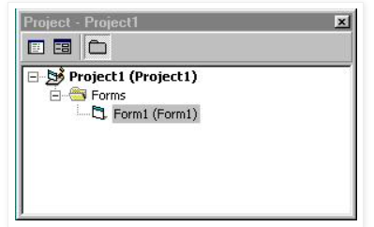
Integrated Development Environment (IDE)
Menu / Toolbar
This is the only element of the IDE which is always visible. We use it to select which other IDE elements to view and to add forms or controls to the project.
Project Window
This is simply a list of all the forms which make up your VB project. There are several kinds of forms which we'll talk about later.

Slide 13
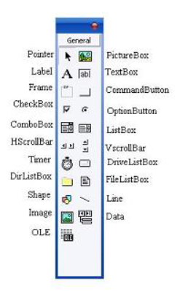
Integrated Development Environment (IDE)
Toolbox
The toolbox is simply a library of controls which we can place on the application. The Toolbox contains a set of controls that are used to place on a Form at design time thereby creating the user interface area. Additional controls can be included in the toolbox by using the Components menu item on the Project menu.

Slide 14
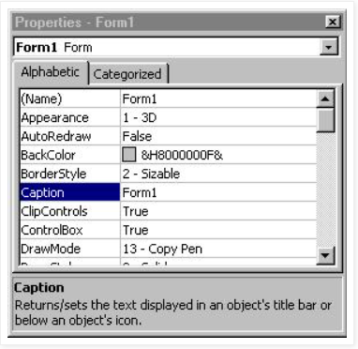
Integrated Development Environment (IDE)
Properties Window
The Properties Window is docked under the Project Explorer window. The Properties Window exposes the various characteristics of selected objects. Each and every form in an application is considered an object. Now, each object in Visual Basic has characteristics such as color and size. Other characteristics affect not just the appearance of the object but the way it behaves too. All these characteristics of an object are called its properties. Thus, a form has properties and any controls placed on it will have properties too. All of these properties are displayed in the Properties Window.

Slide 15
Integrated Development Environment (IDE)
Forms
We can add forms in a VB application as they are needed. They are the windows which hold the various controls (buttons, text boxes, etc.) which make up the application.

Slide 16
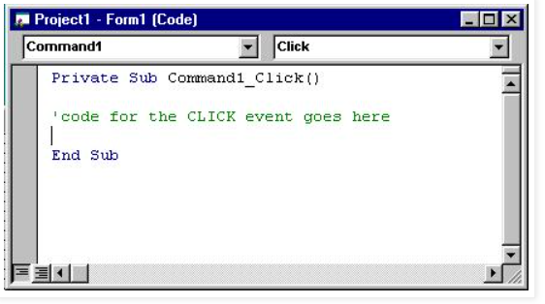
Integrated Development Environment (IDE)
Code Window
Like it's name implies, this window is a place where we can type the code that VB executes. Notice that the heading of the window indicates with which event the code is associated.

Slide 17
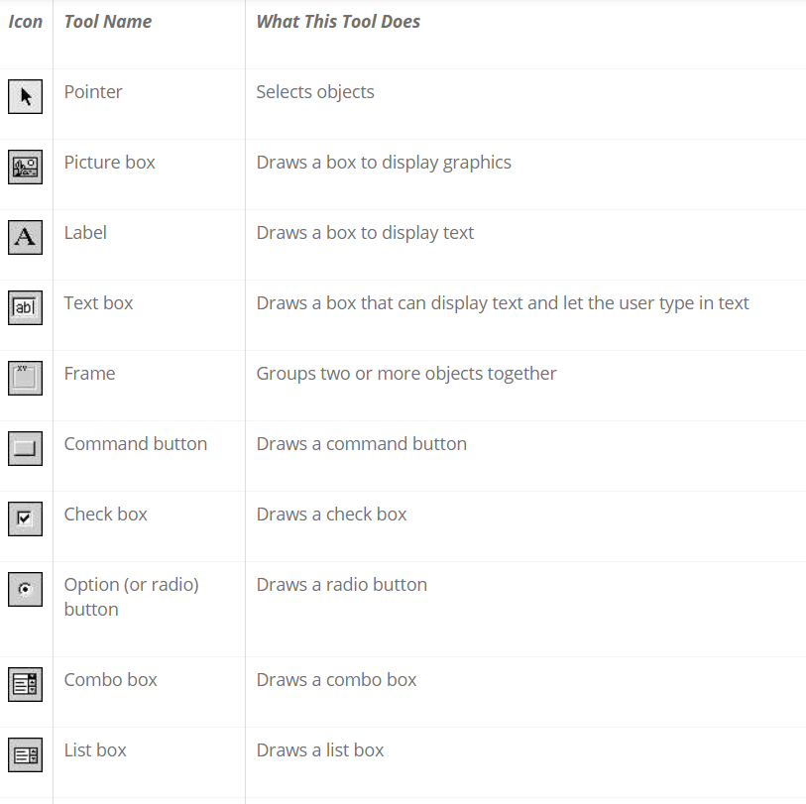
Controls on ToolBox

Slide 18
The Form Object
The Form is where the user interface is drawn.
It is central to the development of Visual Basic applications.
It contains all other GUI components such as text box, command button , label etc.
Form Properties:
Property | Description
Name | Used to give a name to a form
Caption | It sets the form window title
BackColor | Sets the form background color
BorderStyle | Sets the form border to be fixed or sizeable.
MaxButton | It can be True or False. If set to False, the maximize button is not displayed
MinButton | It can be True or False. If set to False, the minimize button is not displayed
Top and Left | It determine the position or location of the form on the window
Width and Height | It decides the size of the form.

Slide 19
The Form Object
Form Methods:
Examples
frmExample.Cls clears the form
frmExample.Print "This will print on the form"
Method | Description
Cls | Clears all graphics and text from form. Does not clear any objects
Print | Prints text string on the form
Open | Used to open a form
Move | Used to move a form to a new position.

Slide 20
The Form Object
Form Events:
Events | Description
Click | Form_Click event is triggered when user clicks on form.
DblClick | Form_DblClick event is triggered when user doubleclicks on form
Load | Form_Load event occurs when form is loaded.
Unload | Form_Unload event occurs when form is unloaded
Resize | Form_Resize event occurs when auser resizes a window

Slide 21
The Command Button
The Command Button control is use to create buttons with a variety of uses on a form.
A command button is the most basic way to get user input while a program is running.
By clicking a command button, the user requests that a specific action be taken in the program.
Command Button Properties:
Property | Description
Name | Used to give a name to a command button
Caption | Text to be displayed on button
Cancel | Allows selection of button with Esc key (only one button on a form can have this property True)
Default | Allows selection of button with Enter key (only one button on a form can have this property True).
BackColor | Sets the command button background color
TabIndex | Sets the order in which the controls will get focus when the tab key is pressed
ToolTipText | When this property is set, the text will popup over the command button when user hovers the mouse pointer over it.

Slide 22
Command Button Methods:
Command Button Events:
Method | Description
Move | Used to move a command button during program execution.
SetFocus | Sets the focus to command button
Events | Description
Click | Event triggered when button is selected either by clicking on it or by pressing the access key.
GotFocus | Occurs when the button gets focus either from the tab key, when it is clicked on by the user or by using the SetFocus
LostFocus | It occurs when the command button loses focus.

Slide 23
The Text Box
A Textbox is used to display information entered at design time, by a user at run-time, or assigned within code.
The displayed text may be edited.
The Textbox control is one of the most versatile tools in the Visual Basic toolbox.
This control performs two functions:
Displaying output (such as operating instructions or the contents of a file) on a form.
Receiving text (such as names and phone numbers) as user input.

Slide 24
The Text Box
Text Box Properties: txtName.Text=“Submit” txtName=“Submit”
Property | Description
Name | Used to give a name to a text box
Alignment | To change the alignment of text within the text box. The values can only be set at design time and not at run time.
Enabled | Value must be True or False. If False, user cannot enter data into the text box but can be displayed through the program.
MaxLength | Limits the length of displayed text (0 value indicates unlimited length)
MultiLine | Specifies whether text box displays single line or multiple lines
Text (Default Property) | To read or set the text in the text box.
PasswordChar | Hides text with a single character
Font | Sets font type, style, size.

Slide 25
Text Box Methods:
Text Box Events:
Method | Description
SetFocus | Sets the focus to text box
Events | Description
Change | Triggered every time the Text property changes
Click | Event triggered when button is selected either by clicking on it or by pressing the access key.
GotFocus | Occurs when the text box gets focus either from the tab key, when it is clicked on by the user or by using the SetFocus
LostFocus | It occurs when the text box loses focus.
KeyPress | Triggered whenever a key is pressed. Used for key trapping, as seen in last class.
KeyDown | Triggered when a key is pressed while the focus is in a text box.
KeyUp | Triggered when a key is released while the focus is in a text box.

Slide 26
The Label
Label, the simplest control in the Visual Basic toolbox, displays formatted text on a user interface form.
The label cannot be changed directly by the user at run time.
Its contents can be changed through the program or at design time.
Typical uses for the Label control include:
Help text
Program splash screen headings
Formatted output, such as names, times, and dates
Descriptive labels for other objects, including text boxes and list boxes.

Slide 27
The Label
Label Properties:
Property | Description
Name | Used to give a name to a label
Alignment | Aligns caption within border.
Caption (Default Property) | Text to be displayed on the label. This can be changed at design time or at run time
FontBold | To display the text in a bold font
FontItalic | To display the text in a italic font
WordWarp | If True, the text in the caption will display in multiple lines.

Slide 28
Label Methods:
Label Events:
Method | Description
Move | Moves the label at run time
Events | Description
Click | Event triggered when user clicks on a label.
DblClick | Event triggered when user double-clicks on a label
Change | Triggered when the text of the label is changed by the application.

Slide 29
The Check Box
Check boxes provide a way to make choices from a list of potential options.
Some, all, or none of the choices in a group may be selected
In any group of check boxes, any number of check boxes can be selected.
If check box is selected , its Value property becomes 1 otherwise it becomes 0.
Check Box Properties:
Check Box Events:
Property | Description
Name | Used to give a name to a check box
Caption | Identifying text next to box
Value (Default Property) | Indicates if unchecked (0, vbUnchecked), checked (1,vbChecked), or grayed out (2, vbGrayed).
Events | Description
Click | Triggered when a box is clicked. Value property is automatically changed by VB

Slide 30
The Option Button (Radio Button)
Option buttons provide the capability to make a mutually exclusive choice among a group of potential candidate choices.
Hence, option buttons work as a group, only one of which can have a True (or selected) value.
All related option buttons must be placed inside the frame and not on the form.
Option Button Properties:
Option Button Events:
Property | Description
Name | Used to give a name to a option button
Caption | Identifying text next to option button
Value (Default Property) | Indicates if selected (True) or not (False). Only one option button in a group can be True. One button in each group of option buttons should always be initialized to True at design time.
Events | Description
Click | Triggered when a option button is clicked. Value property is automatically changed by VB

Slide 31
List Box
A list box displays a list of items from which the user can select one or more items.
If the number of items exceeds the number that can be displayed, a scroll bar is automatically added.
List Box Properties:
Property | Description
Name | Used to give a name to a list box
List | Array of items in list box
ListCount | Number of items in list.
ListIndex | The number of the most recently selected item in list
MultiSelect | Controls how items may be selected (0-no multiple selection allowed, 1-multiple selection allowed, 2-group selection allowed)
Selected | Array with elements set equal to True or False,depending on whether corresponding list item is selected.
Sorted | True means items are sorted in Ascii order, else items appear in order added.
Text | Text of most recently selected item.

Slide 32
List Box Methods:
List Box Events:
Method | Description
Click | Event triggered when item in list is clicked
DblClick | Event triggered when item in list is double-clicked.Primary way used to process selection.
Events | Description
AddItem | Allows you to insert item in list
Clear | Removes all items from list box.
RemoveItem | Removes item from list box, as identified by index of item to remove.

Slide 33
Combo Box
The combo box is similar to the list box.
The differences are a combo box includes a text box on top of a list box and only allows selection of one item.
In some cases, the user can type in an alternate response.
Combo Box Properties:
Property | Description
Name | Used to give a name to a Combo box
List | Array of items in list box
ListCount | Number of items in list.
ListIndex | The number of the most recently selected item in list
Style | Selects the combo box form.Style = 0, Dropdown combo; user can change selection.Style = 1, Simple combo; user can change selection. Style = 2, Dropdown combo; user cannot change selection.
Sorted | True means items are sorted in Ascii order, else items appear in order added.
Text | Text of most recently selected item.

Slide 34
Combo Box Methods:
Combo Box Events:
Method | Description
Click | Event triggered when item in list is clicked
DblClick | Event triggered when item in list is double-clicked.Primary way used to process selection.
Events | Description
AddItem | Allows you to insert item in list
Clear | Removes all items from list box.
RemoveItem | Removes item from list box, as identified by index of item to remove.

Slide 35
Picture Boxes
The picture box allows you to place graphics information on a form.
It is best suited for dynamic environments - for example, when doing animation.
They behave very much like small forms within a form, possessing most of the same properties as a form.
Picture Box Properties:
Picture Box Events:
Property | Description
Name | Used to give name for the picture box
Font | Sets the font size, style, and size of any printing done in the picture box
Picture | Establishes the graphics file to display in the picture box
Method | Description
Click | Triggered when a picture box is clicked
DblClick | Triggered when a picture box is double- clicked.

Slide 36
Picture Boxes
The picture box allows you to place graphics information on a form.
It is best suited for dynamic environments - for example, when doing animation.
They behave very much like small forms within a form, possessing most of the same properties as a form.
Picture Box Properties:
Picture Box Events:
Property | Description
Name | Name of the picture box
AutoSize | If True, box adjusts its size to fit the displayed graphic
Font | Sets the font size, style, and size of any printing done in the picture box
Picture | Establishes the graphics file to display in the picture box
Method | Description
Click | Triggered when a picture box is clicked
DblClick | Triggered when a picture box is double- clicked.

Slide 37
Image Tool
The image box holds a picture.
Set the Picture property to an image file with extension .JPG, .BMP, .GIF, .CUR or .WMF
Image Tool Box Properties:
Image Tool Events:
Property | Description
Name | Name of the picture box
Picture (Default Property) | Establishes the graphics file to display in the image box
Stretch | Specifies whether a picture is to be resized to fit the size of the image control
Method | Description
Click | Triggered when a image control is clicked

Slide 38
Frames
Frames provide a way of grouping related controls on a form. And, in the case of option buttons, frames affect how such buttons operate.
Option buttons within a frame work as a group, independently of option buttons in other frames.
Option buttons on the form, and not in frames, work as another independent group.
That is, the form is itself a frame by default.
It is important to note that an independent group of option buttons is defined by physical location within frames, not according to naming convention.
That is, a control array of option buttons does not work as an independent group just because it is a control array.
It would only work as a group if it were the only group of option buttons within a frame or on the form.

Slide 39
Shape Tool
The shape tool can create circles, ovals, squares, rectangles, and rounded squares and rectangles.
Colors can be used and various fill patterns are available.•Shape Tool Properties:
Property | Description
Name | Name of the shape tool
BackColor | Determines the background color of the shape (only used when FillStyle not Solid.
BackStyle | Determines whether the background is transparent or opaque.
BorderColor | Determines the color of the shapes outline.
BorderStyle | Determines the style o the shapes outline. The border can be transparent, solid, dashed, dotted, and combinations.
BorderWidth | Determines the width of the shape border line.
FillColor | Defines the interior color of the shape
FillStyle | Determines the interior pattern of a shape. Some choices are: solid, transparent, cross, etc.
Shape | Determines whether the shape is a square, rectangle, circle, or some other choice 0-Recatnagle, 1 – Square , 2-Oval , 3- Circle, 4- Rounded Rectangle , 5 Rounded Square

Slide 40
The Line Tool
Like the shape control, the line control is a graphical control.
Line is use it to display horizontal, vertical, or diagonal lines in a form.
We can use these controls at design time as a design element or at runtime to alter the original line you drew.
Line Tool Properties:
Property | Description
Name | Name of the line tool
BorderColor | Determines the line color
BorderStyle | Determines the line shape. Lines can be transparent, solid, dashed, dotted, and combinations.
BorderWidth | Determines line width.
BorderStyle | Determines the style o the shapes outline. The border can be transparent, solid, dashed, dotted, and combinations.

Slide 41
The Timer Tool
You use a timer control when you want to execute code at specific intervals.
Many times, especially in using graphics, we want to repeat certain operations at regular intervals.
The timer tool allows such repetition. The timer tool does not appear on the form while the application is running.
Timer Tool Properties:
Property | Description
Name | Name of the timer tool
Enabled | Used to turn the timer on and off. When on, it continues to operate until the Enabled property is set to False
Interval | Number of milliseconds between each invocation of the Timer Event

Slide 42
Combo Box Methods:
Combo Box Events:
Method | Description
Click | Event triggered when item in list is clicked
DblClick | Event triggered when item in list is double-clicked.Primary way used to process selection.
Events | Description
AddItem | Allows you to insert item in list
Clear | Removes all items from list box.
RemoveItem | Removes item from list box, as identified by index of item to remove.

Slide 43
Naming Conventions
Following rules are used to name a variable, constant, procedures and arguments in VB
The name must being with a letter or the alphabet.
The name must consist only of letters, digits, and the underscore character. (No punctuation marks are allowed.)
It should not contain any blank space.
The name can be as long as 255 characters but in practice it must not be more than 40 characters long.
Keyword can not be used as variable name.
While naming a control use the first three characters as a prefix.
Begin each separate word in a name with a capital letter, as in FirstName, LastName , TotalMarks etc.

Slide 44
Object Naming Conventions on VB
Object | Prefix | Example
Form | frm | frmMain
Lablel | lbl | lblName
Text Box | txt | txtName
Command Button | cmd | cmdSave
Check Box | chk | chkLanguage
Option Button | opt | optMale
Combo Box | cbo | cboCounty
List Box | lst | lstHobbies
Image | img | imgIcon
Picture Box | pic | picStudent
Frame | fra | fraGender
Line | lin | linVertical
Shape | shp | shpCircle
Menu | mnu | mnuFile

Slide 45
Modes in VB
Visual Basic has three modes
Design Time :-
The IDE is in design mode when we are writing code or designing a form. The error occurs in the IDE and before compiling the program are called Design Time Errors. Syntax Errors are detected at this stage.
Run Time :-
Run mode occurs when a procedure is running. To run (or execute) a procedure, just place the cursor anywhere within the procedure code and hit the F5 key (or select Run from the Run menu). Certain errors that can be detected only on running the program are called Run time errors.
Break Time :-
Break mode is entered when a running procedure stops because of either an error in the code. In particular, if an error occurs, VB will stop execution and display an error dialog box with an error message.

Slide 46
Errors in VB
Three types of errors can be occurred while running a VB project
Compile Time Error (Syntax Error):-
These are grammatical errors in the formulation of statements and are picked up by the interpreter while you are typing in the code.
Run Time Errors:-
These are errors that cannot be detected until the program is running. The syntax of the statements is correct, but on execution they cause a situation to arise that results in a crash or an undefined value. Run-time errors are those that appear only after you compile and run your code. These involve code that may appear to be correct in that it has no syntax errors, but that will not execute
Logical Errors:-
These are errors that cause the program to behave incorrectly. These are human generated errors. In this program will execute but will give wrong result. ‘<’ instead of ‘<=’, use of ‘and’ instead of ‘or’, or omission of a crucial step in the processing. Logic errors can not be detected by the complier but must be tracked down by the programmer. This is why careful testing is so important.

